Slide 1
Latent Semantic Indexing
Notes:
http://en.wikipedia.org/wiki/Singular_value_decomposition
http://www.uwlax.edu/faculty/will/svd/
http://irthoughts.wordpress.com/2007/05/01/irwatch-may-issue-demystifying-lsi/
http://www.miislita.com/information-retrieval-tutorial/svd-lsi-tutorial-1-understanding.html
http://www.miislita.com/information-retrieval-tutorial/svd-lsi-tutorial-2-computing-singular-values.html
http://www.miislita.com/information-retrieval-tutorial/svd-lsi-tutorial-3-full-svd.html
With examples:
www.cs.nmsu.edu/~mmartin/LSA_Intro_AI_Seminar.ppt

Slide 2
Latent Semantic Indexing
Term-document matrices are very large
But the number of topics that people talk about is small (in some sense)
Clothes, movies, politics, …
Can we represent the term-document space by a lower dimensional latent space?

Slide 3
Linear Algebra Background

Slide 4

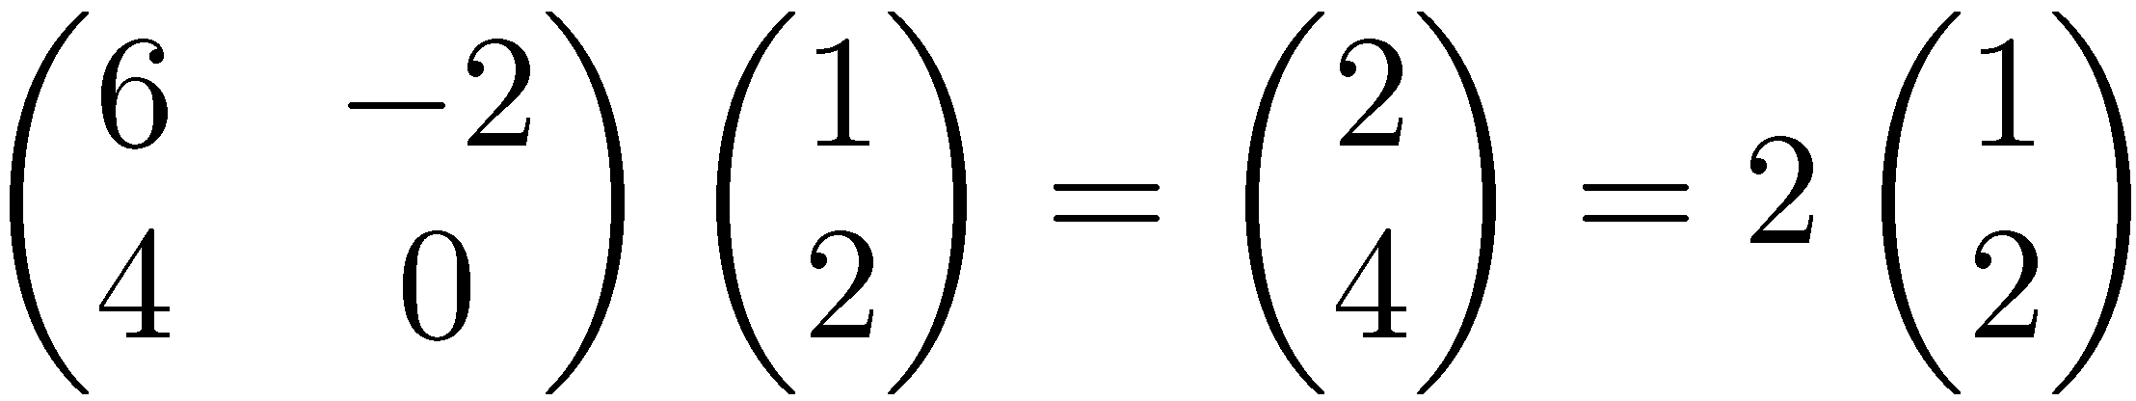
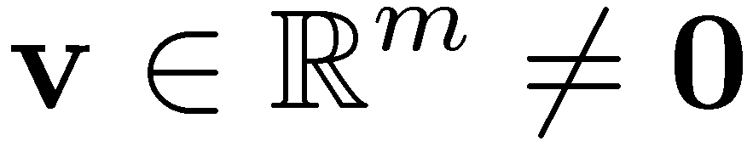

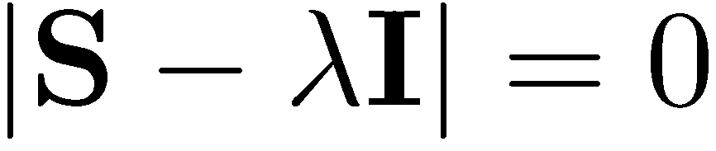
Eigenvalues & Eigenvectors
Eigenvectors (for a square m×m matrix S)
Example
(right) eigenvector
eigenvalue
only has a non-zero solution if
this is a m-th order equation in λ which can have at most m distinct solutions (roots of the characteristic polynomial) – can be complex even though S is real.
Notes:
|…| = determinant (Translation is also a linear transformation.)
A multiplication of a 2D vector with a 2x2 square matrix can be thought of
as a linear transformation of 2D coordinate points involving scaling and rotation.
Under 2D matrix multiplication, eigenvectors are “special” directions that are mapped
parallel to the original directions (that is, they do not suffer rotation). Instead they can
either get magnified or contracted (with eigenvalues serving as the scaling factor).

Slide 5
Matrix-vector multiplication
has eigenvalues 30, 20, 1 with
corresponding eigenvectors
Any vector (say x= ) can be viewed as a combination of
the eigenvectors: x = 2v₁ + 4v₂ + 6v₃

Slide 6
Matrix vector multiplication
Thus a matrix-vector multiplication such as Sx (S, x as in the previous slide) can be rewritten in terms of the eigenvalues/vectors:
Even though x is an arbitrary vector, the action of S on x is determined by the eigenvalues/vectors.
Notes:
If x is described in a coordinate system involving the eigenvectors, the application of S is very straightforward to describe.
It just scales each coordinate using the eigenvalue.

Slide 7
Matrix vector multiplication
Observation: the effect of “small” eigenvalues is small. If we ignored the smallest eigenvalue (1), then instead of
we would get
These vectors are similar (in terms of cosine similarity), or close (in terms of Euclidean distance).

Slide 8
Eigenvalues & Eigenvectors
For symmetric matrices, eigenvectors for distinct
eigenvalues are orthogonal
All eigenvalues of a real symmetric matrix are real.
All eigenvalues of a positive semi-definite matrix
are non-negative
Notes:
Take a Linear Algebra course for concrete proofs!
Orthogonal = Perpendicular = Dot product 0

Slide 9
Example
Let
Then
The eigenvalues are 1 and 3 (nonnegative, real).
The eigenvectors are orthogonal (and real):
Real, symmetric.
Notes:
2 – L= +- 1
[2 1] [x] = [Lx]
[1 2] [y] [Ly]
L = 3 => 2x + y = 3 x x + 2y = 3 y => x = y
Any vector in the direction of eigenvector will work!
L = 1 => 2x + y = x x + 2y = y => x = - y

Slide 10
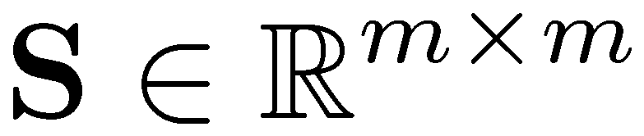
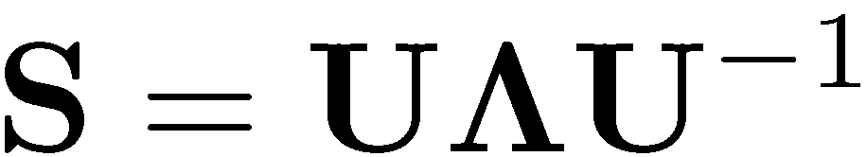


Eigen/diagonal Decomposition
Let be a square matrix with m linearly independent eigenvectors (a “non-defective” matrix)
Theorem: Exists an eigen decomposition
(cf. matrix diagonalization theorem)
Columns of U are eigenvectors of S
Diagonal elements of are eigenvalues of
Unique for distinct eigen-values
diagonal
Notes:
Linear transformation S can be expressed as a diagonal matrix when the points
are represented in the coordinate system of eigenvectors.
U^-1 maps a point from original coordinate system into the canonical coordinate system.
/\ applies the linear transformation via scalar multiplication.
U maps a point back from canonical coordinate system to the original coordinate system.
---------------------------------------------------------------------------------------------------------------
For identifying conic sections (ellipse, parabola, hyperbola, etc) or their 3D counterparts,
one can use the new coordinate system to obtain their tell-tale canonical representations
(lacking cross terms involving xy).
E.g., the canonical equation describing an ellipse is when the coordinate system is aligned
with the major and minor axis (and contains information about their lengths).
x^2 / a^2 + y^2/b^2 = 1

Slide 11
Symmetric Eigen Decomposition
If is a symmetric matrix:
Theorem: There exists a (unique) eigen decomposition
where Q is orthogonal:
Q⁻¹= Q^{T}
Columns of Q are normalized eigenvectors
Columns are orthogonal.
(everything is real)
Notes:
Keep geometric interpretation in mind for visualization.
If U contains unit vectors, it is called an orthogonal matrix characterized by U^T = U^-1
S has a simplified representation in the coordinate system spanned by eigenvectors.
Application of S in ordinary coordinate system can be equivalently described
as mapping the points into coordinate system of eigenvectors by Q^T, scaling the point,
and mapping the points back via Q.

Slide 12
Singular Value Decomposition
For an M × N matrix A of rank r there exists a factorization
(Singular Value Decomposition = SVD) as follows:
M×M
M×N
V is N×N
The columns of U are orthogonal eigenvectors of AA^{T}.
The columns of V are orthogonal eigenvectors of A^{T}A.
Eigenvalues λ₁ … λ_{r} of AA^{T} are the eigenvalues of A^{T}A.
Singular values.
Notes:
rank = number of linearly independent rows or columns A = term document matrix
A^T A = doc-doc correlation (aij proportional to how correlated doc i is to docj)
A A^T = term-term correlation (aij proportional to how correlated term i is to term j)

Slide 13
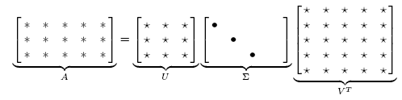
Low-rank Approximation
Solution via SVD
set smallest r-k
singular values to zero
k
column notation: sum
of rank 1 matrices
Notes:
In text retrieval application, lower rank approximation maps 10,000 term-space into 200-dimensional space.
Instead of transmitting 10K x 1M doc/bit matrix, we can obtain 10K x 200 + 200 + 200 x 1M data compression,
or abstraction to better reflect concepts. Terms, documents and queries mapped into 200-dim space and
distance/similarity compared/ranked gives better results.

Slide 14
Reduced SVD
If we retain only k singular values, and set the rest to 0, then we don’t need the matrix parts in red
Then Σ is k×k, U is M×k, V^{T} is k×N, and A_{k} is M×N
This is referred to as the reduced SVD
It is the convenient (space-saving) and usual form for computational applications
k
Notes:
In text retrieval application, lower rank approximation maps 10,000 term-space into 200-dimensional space.
Instead of transmitting 10K x 1M doc/bit matrix, we can obtain 10K x 200 + 200 + 200 x 1M data compression,
or abstraction to better reflect concepts. Terms, documents and queries mapped into 200-dim space and
distance/similarity compared/ranked gives better results.

Slide 15

SVD Low-rank approximation
Whereas the term-doc matrix A may have M=50000, N=10 million (and rank close to 50000)
We can construct an approximation A₁₀₀ with rank 100.
Of all rank 100 matrices, it would have the lowest Frobenius error.

Slide 16
Latent Semantic Indexing via the SVD

Slide 17
What it is
From term-doc matrix A, we compute the approximation A_{k.}
There is a row for each term and a column for each doc in A_{k}
Thus docs live in a space of k<<r dimensions
Notes:
Ak is an M x N matrix but of rank k (while A is an M x N matrix with rank r)

Slide 18
Vector Space Model: Pros
Automatic selection of index terms
Partial matching of queries and documents (dealing with the case where no document contains all search terms)
Ranking according to similarity score (dealing with large result sets)
Term weighting schemes (improves retrieval performance)
Various extensions
Document clustering
Relevance feedback (modifying query vector)

Slide 19
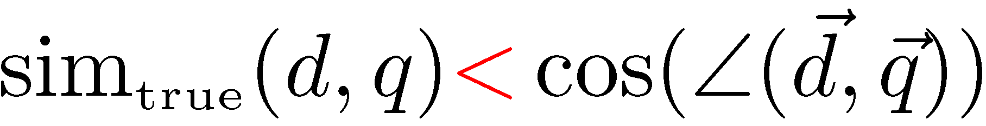
Problems with Lexical Semantics
Ambiguity and association in natural language
Polysemy: Words often have a multitude of meanings and different types of usage (more severe in very heterogeneous collections).
The vector space model is unable to discriminate between different meanings of the same word.

Slide 20
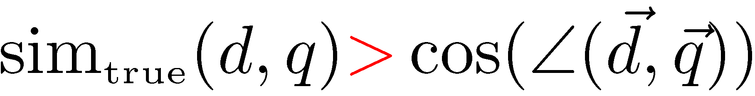
Problems with Lexical Semantics
Synonymy: Different terms may have identical or similar meanings (weaker: words indicating the same topic).
No associations between words are made in the vector space representation.

Slide 21
Polysemy and Context
Document similarity on single word level: polysemy and context
ring
jupiter
•••
space
voyager
meaning 1
…
planet
...
…
saturn
...
meaning 2
car
company
•••
dodge
ford
contribution to similarity, if used in 1st meaning, but not if in 2nd

Slide 22
Latent Semantic Indexing (LSI)
Perform a low-rank approximation of document-term matrix (typical rank 100-300)
General idea
Map documents (and terms) to a low-dimensional representation.
Design a mapping such that the low-dimensional space reflects semantic associations (latent semantic space).
Compute document similarity based on the inner product in this latent semantic space

Slide 23
Goals of LSI
Similar terms map to similar location in low dimensional space
Noise reduction by dimension reduction
Notes:
Distance reduction among similar terms in the new space!
In text retrieval application, representing terms, documents and queries on reduced dimensional space
brings “semantically” related entities closer driven by other CORRELATED terms.
It is ROBUST wrt synonyms because they may appear in similar context, and
wrt polysymy because it picks up documents with the same context.

Slide 24
Performing the maps
Each row and column of A gets mapped into the k-dimensional LSI space, by the SVD.
A query q is also mapped into this space, by
Notes:
Measure distance of query vector to all the documents in LSS to rank them.

Slide 25
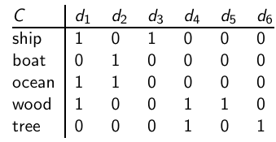
Example of C = UΣV^{T} : The matrix C
This is a standard term-document matrix. Actually, we use a non-weighted matrix here to simplify the example.
25

Slide 26
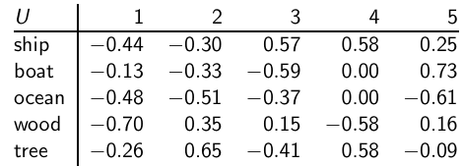
Example of C = UΣV^{T} : The matrix U
One row per term, one column per min(M,N) where M is the number of terms and N is the number of documents. This is an orthonormal matrix:
(i) Row vectors have unit length. (ii) Any two distinct row vectors
are orthogonal to each other. Think of the dimensions (columns) as “semantic” dimensions that capture distinct topics like politics, sports, economics. Each number u_{ij} in the matrix indicates how strongly related term i is to the topic represented by semantic dimension j .
26

Slide 27
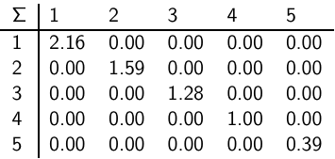
Example of C = UΣV^{T} : The matrix Σ
This is a square, diagonal matrix of dimensionality min(M,N) × min(M,N). The diagonal consists of the singular values of C. The magnitude of the singular value measures the importance of the corresponding semantic dimension. We’ll make use of this by omitting unimportant dimensions.
27

Slide 28
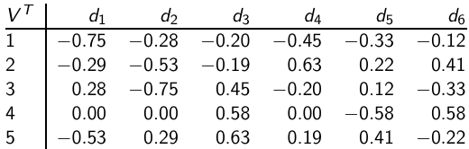
Example of C = UΣV^{T} : The matrix V^{T}
One column per document, one row per min(M,N) where M is the number of terms and N is the number of documents. Again: This is an orthonormal matrix: (i) Column vectors have unit length. (ii) Any two distinct column vectors are orthogonal to each other. These are again the semantic dimensions from the term matrix U that capture distinct topics like politics, sports, economics. Each number v_{ij} in the matrix indicates how strongly related document i is to the topic represented by semantic dimension j .
28

Slide 29
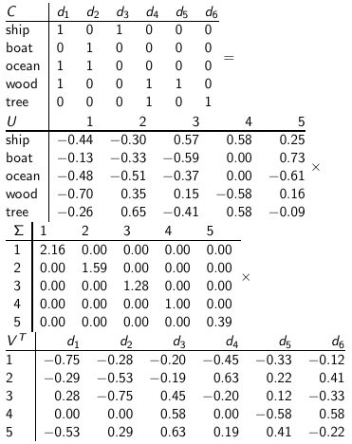
Example of C = UΣV^{T} : All four matrices
29

Slide 30
LSI: Summary
We’ve decomposed the term-document matrix C into a product of three matrices.
The term matrix U – consists of one (row) vector for each term
The document matrix V^{T} – consists of one (column) vector for each document
The singular value matrix Σ – diagonal matrix with singular values, reflecting importance of each dimension
Next: Why are we doing this?
30

Slide 31
How we use the SVD in LSI
Key property: Each singular value tells us how important its dimension is.
By setting less important dimensions to zero, we keep the important information, but get rid of the “details”.
These details may
be noise – in that case, reduced LSI is a better representation because it is less noisy.
make things dissimilar that should be similar – again reduced LSI is a better representation because it represents similarity better.
31

Slide 32
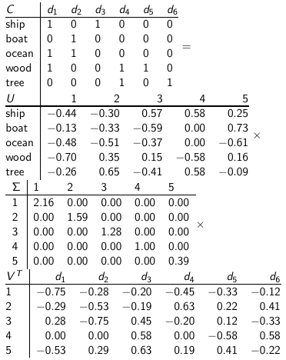
Recall unreduced decomposition C=UΣV^{T}
32

Slide 33
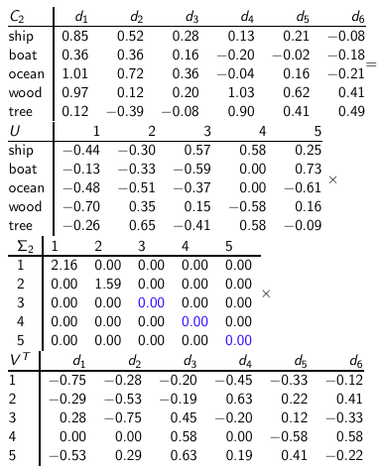
Reducing the dimensionality to 2
33

Slide 34
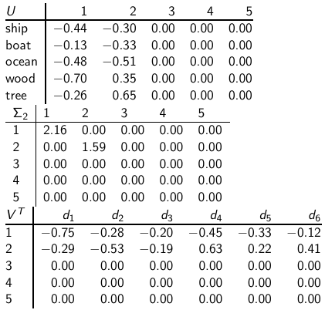
Reducing the dimensionality to 2
Actually, we
only zero out
singular values
in Σ. This has
the effect of
setting the
corresponding
dimensions in
U and V ^{T} to
zero when
computing the
product
C = UΣV ^{T} .
34

Slide 35
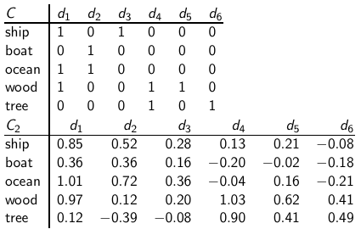
Original matrix C vs. reduced C₂ = UΣ₂V^{T}
We can view
C₂ as a two-dimensional
representation
of the matrix.
We have
performed a
dimensionality
reduction to
two dimensions.
35

Slide 36
Why is the reduced matrix “better”
Similarity of d2 and d3 in the original space: 0.
Similarity of d2 und d3 in the reduced space:
0.52 * 0.28 + 0.36 * 0.16 + 0.72 * 0.36 + 0.12 * 0.20 + - 0.39 * - 0.08 ≈ 0.52
36
Notes:
Does similarity computation require sqrt(Sigma) (scaling by eigenvalues) correction?

